Slide 1
CSE 105 theory of computation
Fall 2020 Week2

Slide 2
Table of Contents – Quickly Jump to a video’s slides
Monday | Wednesday | Friday
Video 15 | Video 21 | Video 26
Video 16 | Video 22 | Video 27
Video 17 | Video 23 | Examples
Video 18 | Video 24 | FAQ
Video 19 | Video 25
Video 20 | Examples
Examples | FAQ
FAQ

Slide 3
This week’s learning goals
Design an automaton that recognizes a given language.
Specify a general construction for DFA based on parameters
Design general constructions for DFA
Motivate the use of nondeterminism
Trace the computation(s) of a nondeterministic finite automaton

Slide 4
Monday
Videos 015-020
Today’s learning goals
Design an automaton that recognizes a given language.
Specify a general construction for DFA based on parameters
Today’s textbook sections
Section 1.1 Example 1.11, Example 1.21

Slide 5
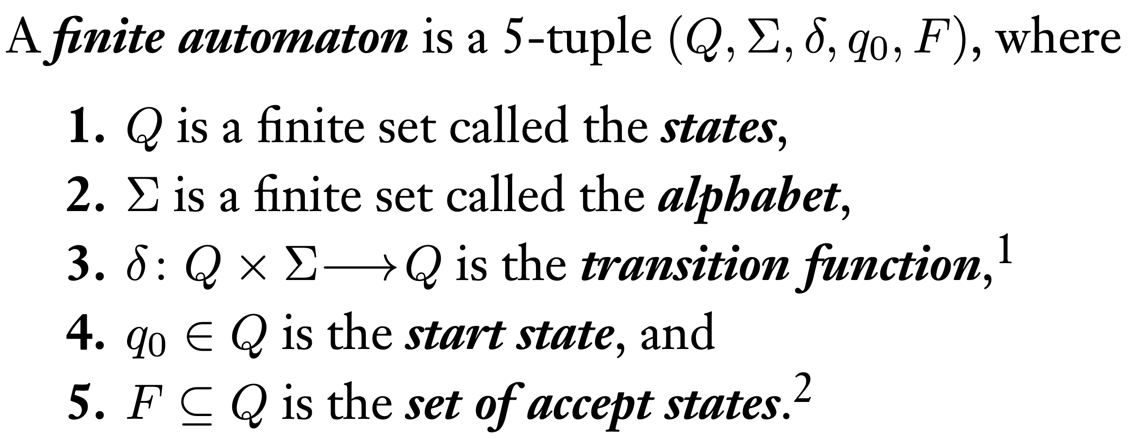
015.CSE105.DFADesignExample1
Remember:
Sipser Def.1.5, pg.35

Slide 6
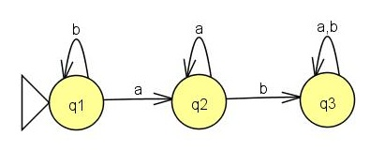
Specifying an automaton
( {q1,q2,q3}, {a,b}, δ, q1, ? )
What state(s) should be in F so that the language of this machine is
{ w | ab is a substring of w}?
{q2}
{q3}
{q1,q2}
{q1,q3}
I don't know.

Slide 7
Specifying an automaton
( {q1,q2,q3}, {a,b}, δ, q1, ? )
What state(s) should be in F so that the language of this machine is
{ w | ab is a substring of w}?
{q2}
{q3}
{q1,q2}
{q1,q3}
I don't know.

Slide 8
Key Notation and Definitions (015)
When in state q1(in this example), the only thing we’ve seen in the input string is the b symbol.

Slide 9
016.CSE105.DFADesignExample2
Remember:
The complement of a set A refers to the set of elements (over the alphabet of A) that are not in A.

Slide 10
Specifying an automaton
( {q1,q2,q3}, {a,b}, δ, q1, ? )
What state(s) should be in F so that the language of this machine is
{ w | b's never occur after a's in w}?
{q2}
{q3}
{q1,q2}
{q1,q3}
I don't know.

Slide 11


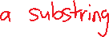


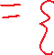

Specifying an automaton
( {q1,q2,q3}, {a,b}, δ, q1, ? )
What state(s) should be in F so that the language of this machine is
{ w | b's never occur after a's in w}?
{q2}
{q3}
{q1,q2}
{q1,q3}
I don't know.

Slide 12
Key Notation and Definitions (016)
b occurs after a's in w = {w | ab is a substring}
{ w | b's never occur after a's in w}
is the complement of
{ w | ab is a substring of w}
When trying to recognize the complement of a language we’ve already described with an automaton, the result is the same state diagram but with accept/non-accept states flipped.

Slide 13

017.CSE105.DFADesignExample3
Remember:
Sipser Def.1.5, pg.35

Slide 14

Building DFA
Example
Define a DFA which recognizes
{ w | w has at least 2 a's}

Slide 15












Building DFA
Example
Define a DFA which recognizes
{ w | w has at least 2 a's}

Slide 16
Key Notation and Definitions (017)
When drawing a diagram, make sure you have the right number of arrows coming out of every state. That is, each state in the DFA has |Σ| outgoing transitions: one outgoing edge for each character in the alphabet.
The empty string ε is not a member of the alphabet, rather it is a string of length 0 over the alphabet. The computation on ε will end at the beginning, at the start state.

Slide 17
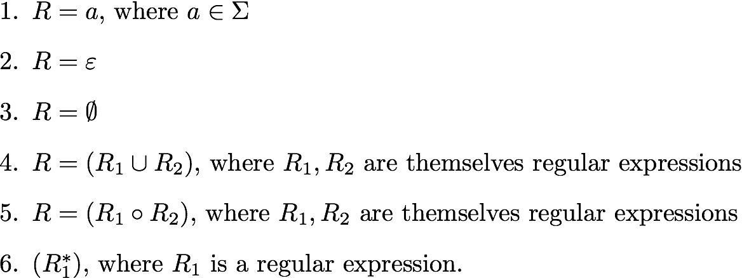
018.CSE105.RegularLanguagesAndJustification.mp4
Remember:
R is a regular expression over the alphabet Σ if
Sipser 1.52 p. 64

Slide 18
Regular languages Sipser p. 35 Def 1.5
DFA M over the alphabet Σ
For each string w over Σ, M either accepts w or rejects w
The language recognized by M is the set of strings M accepts, and is also known as the language of M and written L(M)
A language is regular iff there is some finite automaton that recognizes exactly it.
If we want to show that some pattern is recognized by a machine, we’re showing that the language of the machine is exactly equal to some set of strings.

Slide 19
Building DFA
Definition: A language is regular means there is some DFA that recognizes it.
Typical questions
Define a DFA which recognizes the language L.
or
Prove that the (given) language L is regular.

Slide 20
Justification?
To prove that the DFA we build, M, actually recognizes the language L
WTS L(M) = L
Is every string accepted by M in L?
Is every string from L accepted by M?
or contrapositive version: Is every string rejected by M not in L.

Slide 21




Justification?
To prove that the DFA we build, M, actually recognizes the language L
WTS L(M) = L
Is every string accepted by M in L?
Is every string from L accepted by M?
or contrapositive version: Is every string rejected by M not in L.

Slide 22
Key Notation and Definitions (018)
Given a DFA M over the alphabet Σ
For each string w over Σ, M either accepts w or rejects w
The language recognized by M = language of M = L(M) is the set of strings that M accepts.
A language is regular iff there is some finite automaton that recognizes exactly it.

Slide 23
019.CSE105.FiniteLanguagesAreRegular
Remember:
A finite language is a set that only has finitely many elements.

Slide 24
Regular languages: bounds?
Is every finite language regular?
No: some finite languages are regular, and some are not.
No: there are no finite regular languages.
Yes: every finite language is regular.
I don't know.

Slide 25



Regular languages: bounds?
Is every finite language regular?
No: some finite languages are regular, and some are not.
No: there are no finite regular languages.
Yes: every finite language is regular.
I don't know.
Counter example:

Slide 26
Key Notation and Definitions (019)
A finite language is a set that only has finitely many elements.
EVERY finite language is regular.
We can create a DFA to recognize each finite language.

Slide 27
020.CSE105.RegularLanguagesComplementation.mp4
Remember:
To show that sets A = B, one can show that A ⊆ B and B ⊆ A
A ⊆ B (subset) means that every element in A is also an element in B

Slide 28
Building DFA
Remember
States are our only (computer) memory.
Design and pick states with specific roles / tasks in mind.
"Have not seen any of desired pattern yet"
"Trap state"

Slide 29
Complementation
( {q1,q2,q3}, {a,b}, δ, q1, ? )

Slide 30
Building DFA
New strategy
Express L in terms of simpler languages – use them as building blocks.
Example L = { w | w does not contain the substring baba }
= the complement of the set
{w | w contains the substring baba}

Slide 31
Complementation
Claim: If A is a regular language over {0,1}*, then so is A
aka "the class of regular languages is closed under complementation"

Slide 32
Complementation
Claim: If A is a regular language over {0,1}*, then so is A
aka "the class of regular languages is closed under complementation"
Proof: Let A be a regular language. Then there is a DFA M=(Q,Σ,δ,q0,F) such that L(M) = A. We want to build a DFA whose language is A. Define
M' =
Claim of Correctness L(M') = A
Proof of claim…
?

Slide 33
Complementation
( {q1,q2,q3}, {a,b}, δ, q1, ? )

Slide 34
Complementation
Claim: If A is a regular language over {0,1}*, then so is A
aka "the class of regular languages is closed under complementation"
Proof: Let A be a regular language. Then there is a DFA M=(Q,Σ,δ,q0,F) such that L(M) = A. We want to build a DFA whose language is A. Define
M' =
Claim of Correctness L(M') = A
Proof of claim…

Slide 36
Key Notation and Definitions (020)
If we want to remember what string we’ve seen, it must be encoded by the states.
To prove the class of regular languages is closed under complementation:
Let A be a regular language. Then there is a DFA M=(Q,Σ,δ,q0,F) such that L(M) = A.
Build a DFA whose language is A . Defne M’ =(Q,Σ,δ,q0,F)
We can them prove that L(M') = A

Slide 37
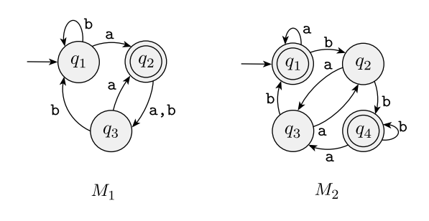
Formal Description of DFAs
Example 1
The machines from Exercise 1.1 for reference
Ch. 1 Exercises pg. 83

Slide 38
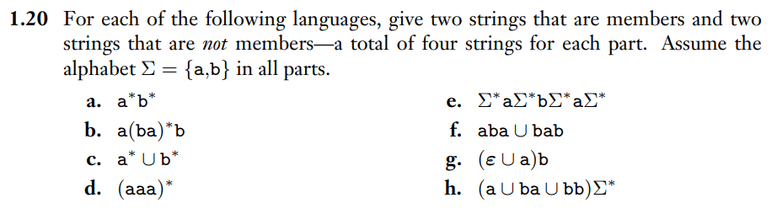
Membership of Strings in Languages
Example 2
Ch. 1 Exercises pg. 86

Slide 39
Monday FAQ (015-020)
Q: "To build a DFA that represents a language L, can we always just flip the accept/non-accept states of the machine whose language is the complement of L?"
A: Yes, we can do that for DFAs. This works because in a DFA, the whole input string can be read, and it will be accepted or rejected based on whether or not the computation ends in an accept state. If we flip the accept and non-accept states, then all the strings that previously ended on an accept state will end on a non-accept state and be rejected, and all the strings that previously ended on a non-accept state will end on an accept state and be rejected.

Slide 40
Monday FAQ (015-020) cont.
Q: "All finite languages are regular, but are all regular languages finite?"
A: Not all regular languages are finite. An example of a regular language that is not finite is the language that contains any numbers of a's, and we can represent it with the regular expression a*. There is an infinite amount strings in this language. An important thing to note is that although there are infinitely many strings in the language, each string in the language is of finite length.

Slide 41
Wednesday
Videos 021-025
Today’s learning goals
Design general constructions for DFA
Motivate the use of nondeterminism
Trace the computation(s) of a nondeterministic finite
automaton
Today’s textbook sections
Section 1.1 Theorem 1.25 (pages 45-47)

Slide 42
021.CSE105.RegularLanguagesClosureProofsIntro.mp4
Remember:
The union (∪) of a collection of sets is the set of all elements in the collection
The intersection of two sets A and B,(A∩B), is the set containing all elements of A that also belong to B

Slide 43
Why closure proofs?
General technique of proving a new language is regular
Stretch the power of the model
Puzzle!

Slide 44
Set operations
Input set(s) → OPERATION → Output set
Complementation
Kleene star
Concatenation
Union
Intersection
Set difference
✔

Slide 45
Key Notation and Definitions (021)
Through closure proofs, we want to show that these set operations preserve regularity.

Slide 46
022.CSE105.RegularLanguagesUnion.mp4
Remember:
The Cartesian product of two sets A and B, denoted A × B, is the set of all ordered pairs (a, b) where a is in A and b is in B.

Slide 47
The regular operations Sipser Def 1.23 p. 44
For A, B languages over same alphabet, define:
These are operations on sets!

Slide 48
Union Sipser Theorem 1.25 p. 45
Theorem: The class of regular languages over fixed alphabet Σ is closed under the union operation.
Proof:
What are we proving here?
For any set A, if A is regular then so is A U A.
For any sets A and B, if A U B is regular, then so is A.
For two DFAs M1 and M2, M1 U M2 is regular.
None of the above.
I don't know.

Slide 49



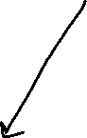
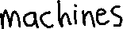
Union Sipser Theorem 1.25 p. 45
Theorem: The class of regular languages over fixed alphabet Σ is closed under the union operation.
Proof:
What are we proving here?
For any set A, if A is regular then so is A U A.
For any sets A and B, if A U B is regular, then so is A.
For two DFAs M1 and M2, M1 U M2 is regular.
None of the above.
I don't know.

Slide 50
Union Sipser Theorem 1.25 p. 45
Theorem: The class of regular languages over fixed alphabet Σ is closed under the union operation.
Proof: Let A1, A2 be any two regular languages over Σ.
WTS that A1 U A2 is regular.
Goal: build a machine that recognizes A1 U A2.

Slide 51
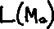
Union Sipser Theorem 1.25 p. 45
Theorem: The class of regular languages over fixed alphabet Σ is closed under the union operation.
Proof: Let A1, A2 be any two regular languages over Σ.
WTS that A1 U A2 is regular.
Goal: build a machine that recognizes A1 U A2.

Slide 52
Union Sipser Theorem 1.25 p. 45
Goal: build a machine that recognizes A1 U A2.
Strategy: use machines that recognize each of A1, A2.
M1
Input
Accept if
either (or both) accepts
M2
** HOW? **

Slide 53
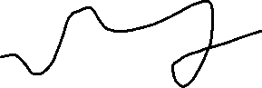
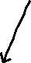
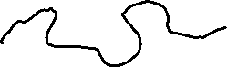
Union Sipser Theorem 1.25 p. 45
Goal: build a machine that recognizes A1 U A2.
Strategy: use machines that recognize each of A1, A2.
M1
Input
Accept if
either (or both) accepts
M2
** HOW? **

Slide 54
"Run in parallel"
M = (Q1xQ2, Σ, δ, ?, ?)
Start state:
Accept state(s):
Transition function:
The set of accepting states for M is
F1 x F2
{ (r,s) | r is in F1 and s is in F2 }
{ (r,s) | r is in F1 or s is in F2 }
F1 U F2
I don't know.

Slide 55
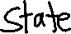
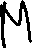
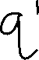
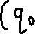
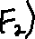

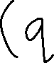

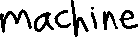
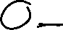
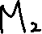
"Run in parallel"
M = (Q1xQ2, Σ, δ, ?, ?)
Start state:
Accept state(s):
Transition function:
q = current state in Q1, q' = current state in Q2
The set of accepting states for M is
F1 x F2
{ (r,s) | r is in F1 and s is in F2 }
{ (r,s) | r is in F1 or s is in F2 }
F1 U F2
I don't know.

Slide 56
Union Sipser Theorem 1.25 p. 45
Proof: Let A1, A2 be any two regular languages over Σ.
Given M1 = (Q1,Σ,δ1,q1,F1) such that L(M1) = A1 and
M2 = (Q2,Σ,δ2,q2,F2) such that L(M2) = A2.
WTS that A1 U A2 is regular.
Define
M = (Q1xQ2,Σ,δ,(q1,q2),{(r,s) in Q1xQ2 | r in F1 or s in F2})
with δ( (r,s), x ) = ( δ1(r,x), δ2(s,x) ) for (r,s) in Q1xQ2 and x in Σ.
Why does L(M) = A1 U A2 ?
Exercise

Slide 57
Key Notation and Definitions (022)
The class of regular languages over a fixed alphabet Σ is closed under the union operation.
Proof idea:
To show that the union of two regular languages, A1 U A2, is regular, build a machine that recognizes A1 U A2.
The new machine takes the cartesian product of the previous inputs.

Slide 58
023.CSE105.DFADesignExampleIntersection.mp4
Remember:
A DFA accepts an input string only after reading all of the input symbols.
There is exactly one outgoing edge from each state labeled by each character in the alphabet.

Slide 59
State diagram for a DFA over {a,b} that recognizes the language
{ w | w has ab as a substring and is of even length}
Label states with their role in the computation’s pattern matching process

Slide 60
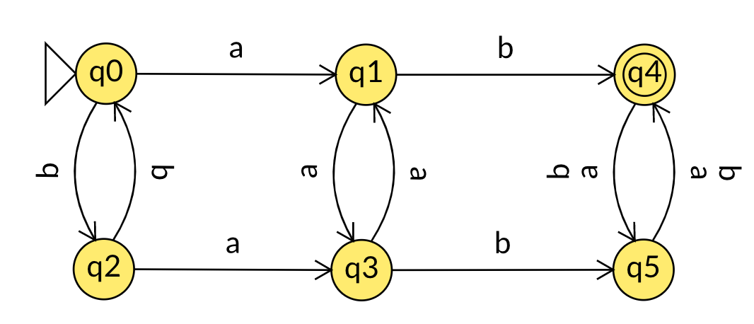
State diagram for a DFA over {a,b} that recognizes the language
{ w | w has ab as a substring and is of even length}
The last symbol we saw was 'a', and we haven't seen 'ab' yet.
An odd number of symbols have been read.
We've seen 'ab'.
An even number of symbols have been read.
'ab' has not been found.
An even number of symbols have been read.
We just saw a 'b'; no progress towards reading 'ab'.
An odd number of symbols have been read.
We've seen 'ab'.
An odd number of symbols have been read.
The last symbol we saw was 'a', and we haven't seen 'ab' yet.
An even number of symbols have been read.
Label states with their role in the computation’s pattern matching process

Slide 61
Key Notation and Definitions (023)
A DFA can only remember finitely into the past and “records” information (such as the length of input string) by knowing which state the computation is currently in.

Slide 62
024.CSE105.RegularLanguagesIntersection.mp4

Slide 63
Intersection Similar to Sipser Theorem 1.25 p. 45
Goal: build a machine that recognizes intersection of A1, A2
Strategy: use machines that recognize each of A1, A2.
Machine M runs M1 and M2 at the same time “in parallel”
How many states will we need in M? Assume n1 is # states in M1 and n2 is # states in M2.
n1+n2
max (n1,n2)
n1 * n2
n1^{n2}
None of the above
M1
Accept iff
both would accept
Input
M2

Slide 64
Intersection Similar to Sipser Theorem 1.25 p. 45
Goal: build a machine that recognizes intersection of A1, A2
Strategy: use machines that recognize each of A1, A2.
Machine M runs M1 and M2 at the same time “in parallel”
How many states will we need in M? Assume n1 is # states in M1 and n2 is # states in M2.
n1+n2
max (n1,n2)
n1 * n2
n1^{n2}
None of the above
M1
Accept iff
both would accept
Input
M2

Slide 65
Intersection
Machine M runs M1 and M2 at the same time “in parallel”
M1
Accept iff
both would accept
Input
Formal construction:
Given M1 = (Q1, Σ, δ1, q1, F1) M2 = (Q2, Σ, δ2, q2, F2)
M2

Slide 66
Intersection
Machine M runs M1 and M2 at the same time “in parallel”
M1
Accept iff
both would accept
Input
Formal construction:
Given M1 = (Q1, Σ, δ1, q1, F1) M2 = (Q2, Σ, δ2, q2, F2)
Build M = (Q1 x Q2, Σ, δ, (q1, q2), F1xF2) where
δ( ( (r1,r2) , a ) ) = (δ1 ( (r1,a) ) , δ2 ( (r2,a) ) )
a is an element of the alphabet
r1 is an element of Q1
r2 is an element of Q1
M2

Slide 67
Key Notation and Definitions (024)
No matter what the language is, if we can express it as the intersection of two sets, then we can produce a DFA to recognize it.
A general approach to design such a complex DFA is to encode all the relevant information about M1 and M2 in each state of the machine M that we’re building.
The new machine M accepts a string if a computation of the new machine lands in a state that represents both the machine M1 and M2 being “happy”(accept).

Slide 68
Key Notation and Definitions (024)
Formal Construction of machine M
Given M1 = (Q1, Σ, δ1, q1, F1) M2 = (Q2, Σ, δ2, q2, F2)
Build M = (Q1 x Q2, Σ, δ, (q1, q2), F1xF2)
where
δ(((r1, r2), a)) = ( δ1 ((r1, a)) , δ2((r2, a)) )
a is an element of the alphabet
r1 is an element of Q1
r2 is an element of Q1

Slide 69
025.CSE105.IteratedTransitionFunction.mp4
Remember:
Sipser Def.1.5, pg.35

Slide 70
Intersection
Machine M runs M1 and M2 at the same time “in parallel”
M1
Accept iff
both would accept
Input
Formal construction:
Given M1 = (Q1, Σ, δ1, q1, F1) M2 = (Q2, Σ, δ2, q2, F2)
Build M = (Q1 x Q2, Σ, δ, (q1, q2), F1xF2) where
δ( ( (r1,r2) , a ) ) = (δ1 ( (r1,a) ) , δ2 ( (r2,a) ) )
a is an element of the alphabet
r1 is an element of Q1
r2 is an element of Q1
M2

Slide 71
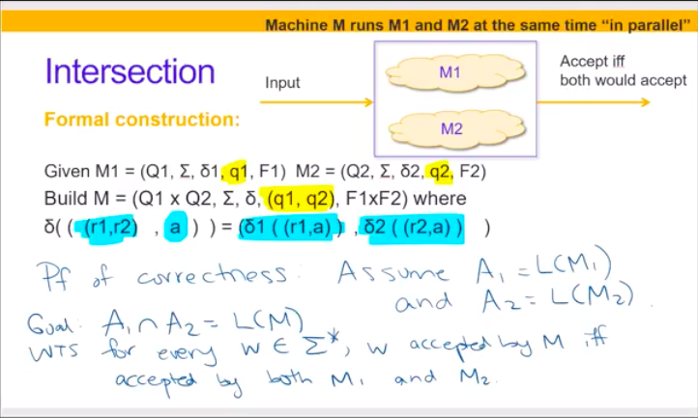

Slide 72
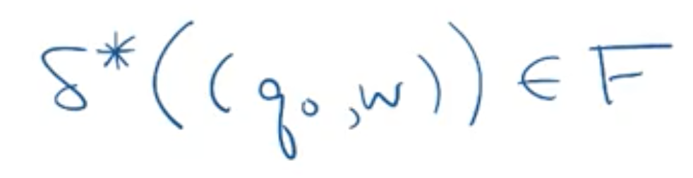
Iterated transition function
Recursively defined function
Suppose M = (Q,Σ,δ,q0,F)
δ*( (q, w) ) =
Computation of M on w: where do we land when start at q₀ and read each symbol of w one-at-a time?
M accepts a string w if and only if

Slide 73
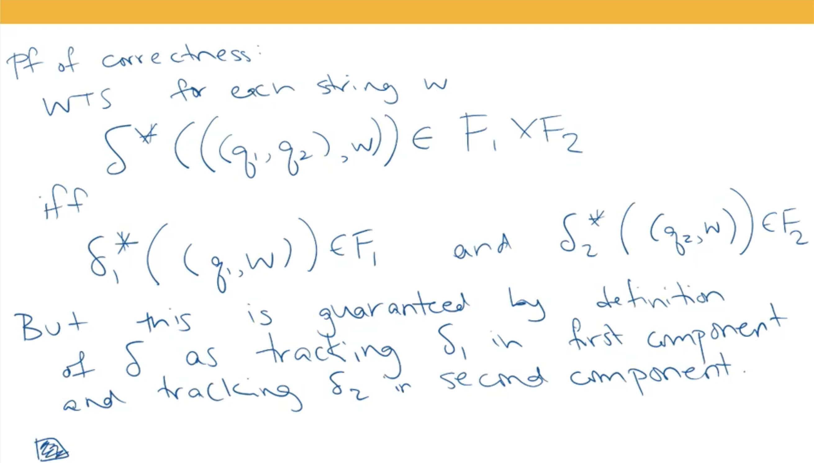

Slide 74
Key Notation and Definitions (025)
Through the proof of correctness, we know the new transition function
δ(((r1, r2), a)) = ( δ1 ((r1, a)) , δ2((r2, a)) )
a is an element of the alphabet
r1 is an element of Q1
r2 is an element of Q1
indeed allows machine M to run M1 and M2 at the same time “in parallel” and lets M accept iff both M1 and M2 accept.

Slide 75
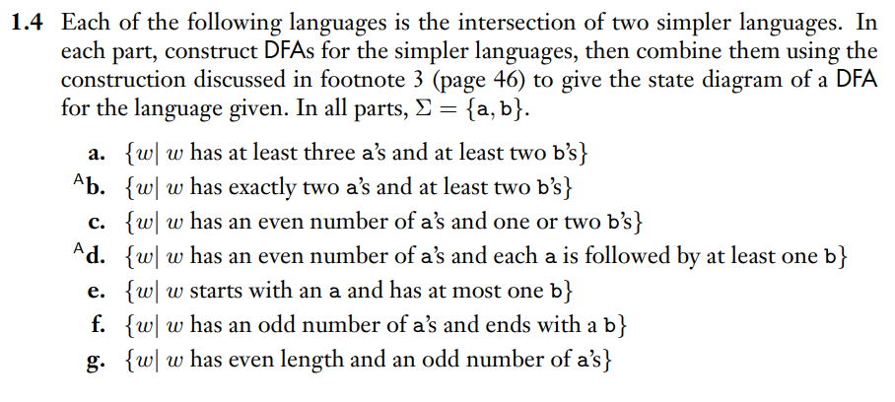
DFAs for the Intersection of Languages
Example 1
Ch. 1 Examples pg. 83

Slide 76
Wednesday FAQ (021-025)
Q: "Why do we need two parentheses in a transition function, like δ((q0,a))?"
A: The outer parentheses indicate where the input begins and ends, and the inner parentheses are present because the input is an ordered pair, and we normally enclose ordered pairs in parentheses.
Q: "What is a 'closure claim'?"
A: This is an example of a closure claim: "The set of regular languages is closed under complementation". This claim states that if the complementation operation is performed on any regular language, the result will also be a regular language. In other words, the set of regular languages is "closed" under complementation.

Slide 77
Wednesday FAQ (021-025)
Q: "Are we allowed to build DFAs with states denoted by tuples or sets of sets?"
A: Yes. We can choose whatever labels we like for the state in a DFA. The only restriction is that the set of states in a DFA is finite. Labels that are tuples are useful in the construction we used to prove that the class of regular languages is closed under union and intersection. Labels that are sets of sets will be useful in a construction we'll see soon.

Slide 78
Friday
Videos 026-027
Today’s learning goals
NFA introduction
Today’s textbook sections
Sipser 1.2 Introduction

Slide 79
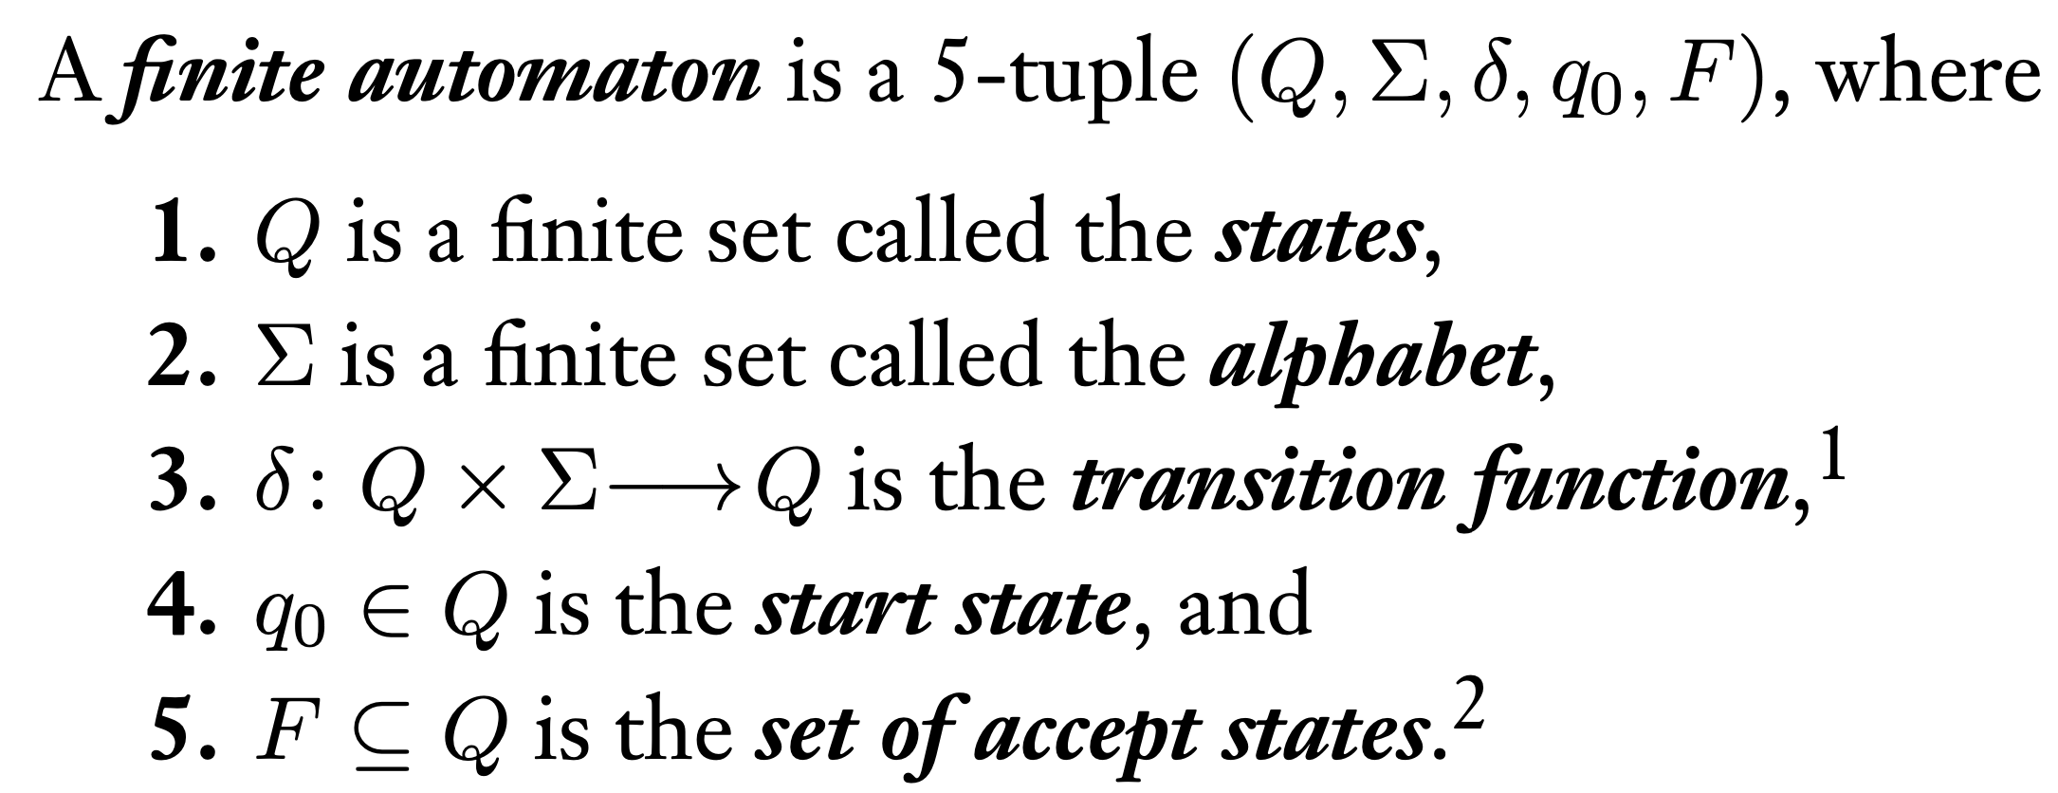
026.CSE105.NFAMotivationAndDefinition.mp4
Remember:
Sipser p. 35 Def 1.5

Slide 80
Building a DFA recognizing a given language L
Directly: use states to label pattern we’ve seen in symbols read so far
Indirectly: Rewrite L as the
* complement of simpler language, or
* intersection of two simpler languages, or
* union of two simpler languages
Build DFAs for simpler language(s), then use general construction.

Slide 81
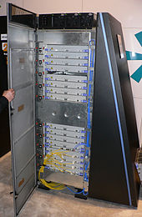
Plan:
Add parallelism to the computation model
This allows new basic building blocks when designing machines recognizing languages
Prove that parallelism can be simulated (at some cost) by “normal” computation

Slide 82
…structure i was using to display the output was a TreeCtrl, so I figured some kind of weird tree traversal system would work and i made it into this implicit state machine that used a stack to traverse up and down into different levels. In short, it was an absolute monster of a structure (which i am immensely proud of for continuing to work as new requirements were added every couple of hours :p). Needless to say, all that code is now gone. Tuesday I came in on a mission to reimplement the tree without any interruption in the continual updating of my project. This was made possible by mentor deciding to just disappear into thin air for the day. I designed am NFA(thanks be Shacham) that could cover every case and also allow the timeline to be completely extensible. Note, I needed an NFA because there are a few input strings that require up to 5 transitions (the tree gets really deep) and the states couldn't really be just jumped to because of the way the TreeCtrl works. After lunch, I implemented this NFA (as it turns out, there was a slight amount of copy and paste) and had it working and fully functional within an hour. On Wednesday, I arranged a short meeting with my mentor to show it off and discuss some requirements for a side project I was to begin working on. When my mentor showed up to the meeting, he brought with him a Qualstar for me! Qualstars are internal awards given to employees who exceed expectations and provide excellent work (or something like that) and I got one for completing my first project so quickly and saving engineer time.
I FINALLY USED SOMETHING I LEARNED AT UCSD WHICH I NEVER THOUGHT I WOULD USE!!!!! i used CSE 105 to design my NFA and knew that an NFA would be a good way to solve this problem only because of that class. Also, that Qualstar i got kinda feels like a real world A+, except it actually means something :p
Chris Miranda (CSE 197)

Slide 83
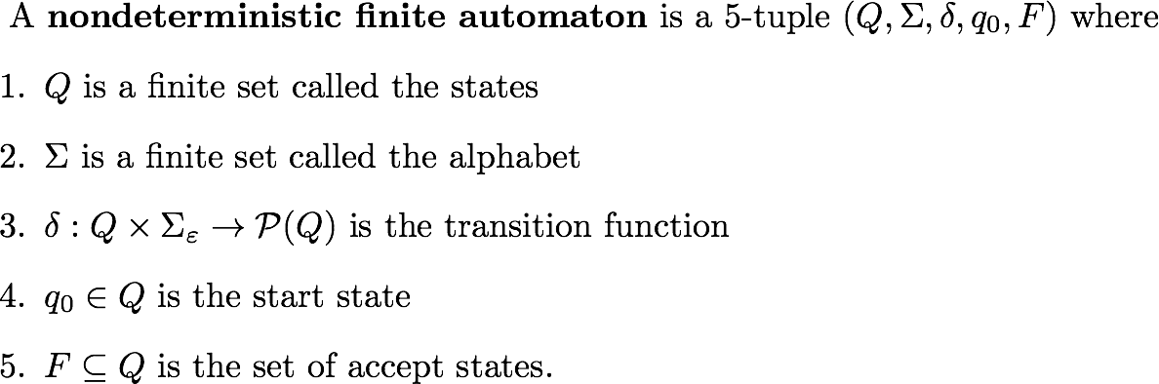
Formal definition of NFA Def 1.37 p. 53
Which piece of the definition of NFA means there might be more than one possible next state from a given state, when reading symbol x from the alphabet?
Line 2, the size of Σ
Line 3, the domain of δ
Line 3, the codomain of δ
Line 5, that F is a set
I don't know.

Slide 84

Formal definition of NFA Def 1.37 p. 53
Which piece of the definition of NFA means there might be more than one possible next state from a given state, when reading symbol x from the alphabet?
Line 2, the size of Σ
Line 3, the domain of δ
Line 3, the codomain of δ
Line 5, that F is a set
I don't know.

Slide 85
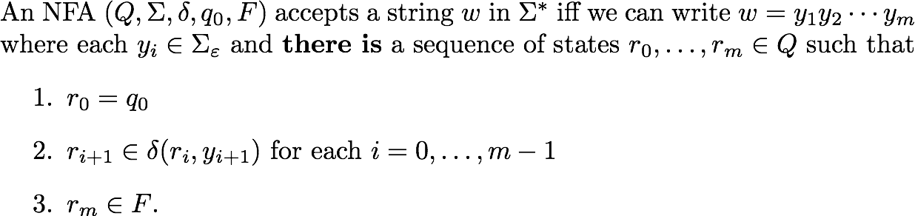
Acceptance in an NFA

Slide 86
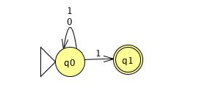
Formal definition?
The language over {0,1} recognized by this NFA is:

Slide 87
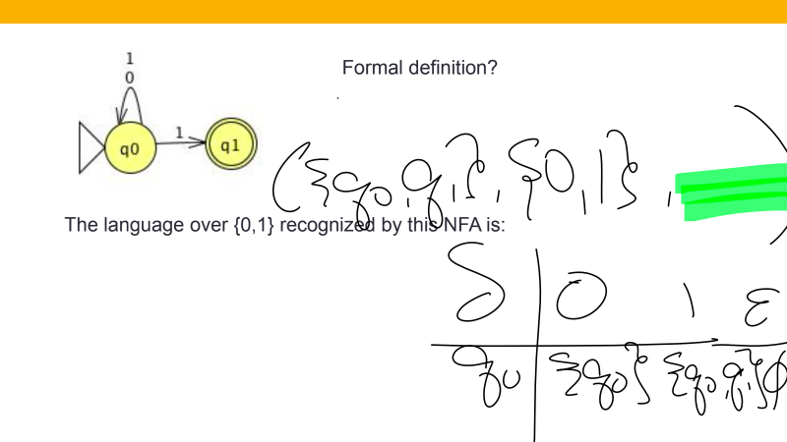

Slide 88
Key Notation and Definitions (026)
In a NFA, there might be more than one possible next state from a given state, since the output of the transition function P(Q) is a set of states.
Sipser Def 1.37 p. 53

Slide 89
027.CSE105.NFAOverviewAndExample

Slide 90
Plan
Use nondeterminism to build machines that will recognize the outputs of these set operations.
Show that this nondeterminism is not essential: nondeterministic machines can be converted to deterministic ones.

Slide 91
Differences between NFA and DFA
DFA: unique computation path for each input
NFA: allow several (or zero) alternative computations on same input
δ((q,x)) may specify more than one possible next states
ε transitions allow the machine to transition between states spontaneously, without consuming any input symbols
Computations can get "stuck" before reading the whole input string.

Slide 92
Tracing NFA execution
Is 0 accepted?
Is 1 accepted?
Find a length 3 string that is accepted.
Find a length 3 string that is rejected.
Is the empty string accepted?
What's the language of this NFA?

Slide 93
Tracing NFA execution
δ((q0, 1)) = {q0, q1}
Is 0 accepted?
Is 1 accepted?
Find a length 3 string that is accepted.
Find a length 3 string that is rejected.
Is the empty string accepted?
What's the language of this NFA?

Slide 94
Acceptance in an NFA

Slide 95





Acceptance in an NFA

Slide 96
Tracing NFA execution
Exercise
What's an example of a NFA, N, whose start state is not accepting but where ε is in L(N)?
Impossible!
Modify picture above by adding double circle at q0.
Modify picture above by removing self loops at q0.
Modify picture above by adding spontaneous move from q0 to q1.
I don't know.

Slide 97
Key Notation and Definitions (027)
DFA: has a unique computation path for each input
NFA: allows several (or zero) alternative computations on the same input
δ((q,x)) may specify more than one possible next state
ε transitions allow the machine to transition between states spontaneously, without consuming any input symbols
If there’s no outgoing transition from a particular state labeled by the character we’re trying to read, computations can get "stuck" before reading the whole input string.
A “stuck” computation is not a successful computation.
A successful computation means that the NFA reads the whole input string and lands in an accept state.

Slide 98
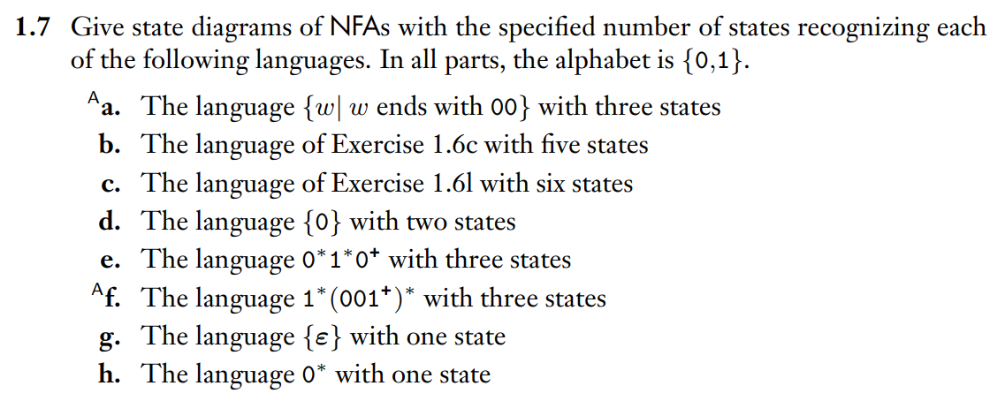
Designing NFAs
Example 1
Ch. 1 Exercises pg. 84

Slide 99
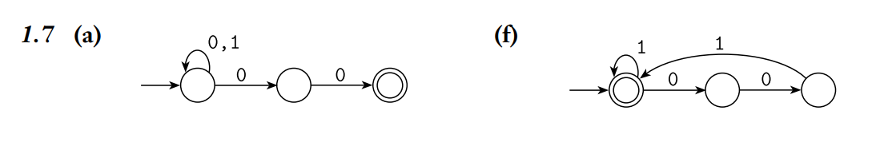
Example 1 Solution
Ch. 1 Solutions pg. 96

Slide 100
Friday FAQ (026-027)
Q: "What is the difference between parallelism and nondeterminism? Are they the same thing?"
A: Parallelism is a specific implementation of nondeterminism. Nondeterminism is a theoretical construct.
Q: "When a string can have multiple different paths through the computation, does it have to get accepted in every possible path for the string to be accepted by the machine?"
A: There only has to be 1 path in which the string is accepted in order for the machine to accept the string. It does not matter how many paths would reject the string; there only has to be 1 that accepts it.

Slide 101
Friday FAQ (026-027) cont.
Q: "What happens when the computation has not yet read all the symbols in the string, but there are no possible transitions that will let us finish reading the string?"
A: This is what we call a "stuck" computation. The machine rejects the string.
Q: "In what situations will a string get rejected by an NFA?"
A: A string is rejected if either the whole string has been read and the computation ends on a state that is not an accept state, or if the whole string cannot be read and the computation is in a "stuck" state.

Slide 102
Friday FAQ (026-027) cont.
Q: "How do we decide which state to transition to when there are multiple different states in the output of the transition function?"
A: This is where the computation tree is useful. When we're tracing through computation, we can choose any path that the transition function allows, and if needed, we can go back to the other paths later. As long as one path leads us to read the entire string and end at an accept state, the machine accepts the string.

